Slide 1
Friend Blend
Team 007
Sangeeth Reddy
Rudrabha Mukhopadhyay
Notes:
Hi, and a very good evening to everyone. We are a group of two, me (Sangeeth Reddy) & my team mate (Rudrabha), & our group name is “Team007”. Our project title is Friend Blend.

Slide 2
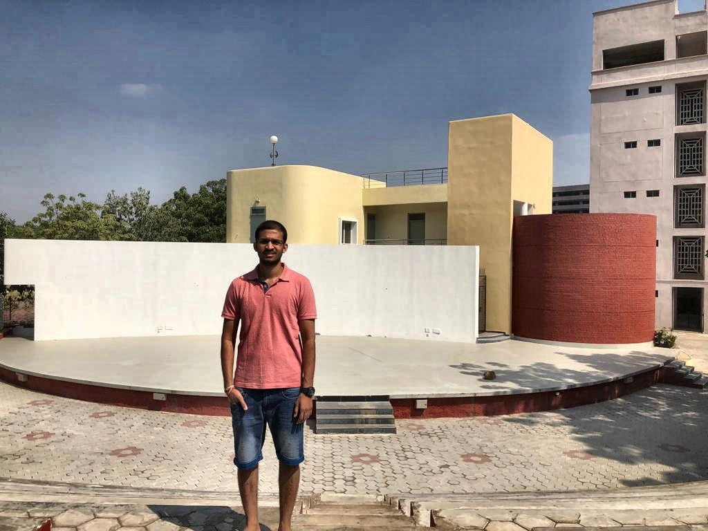
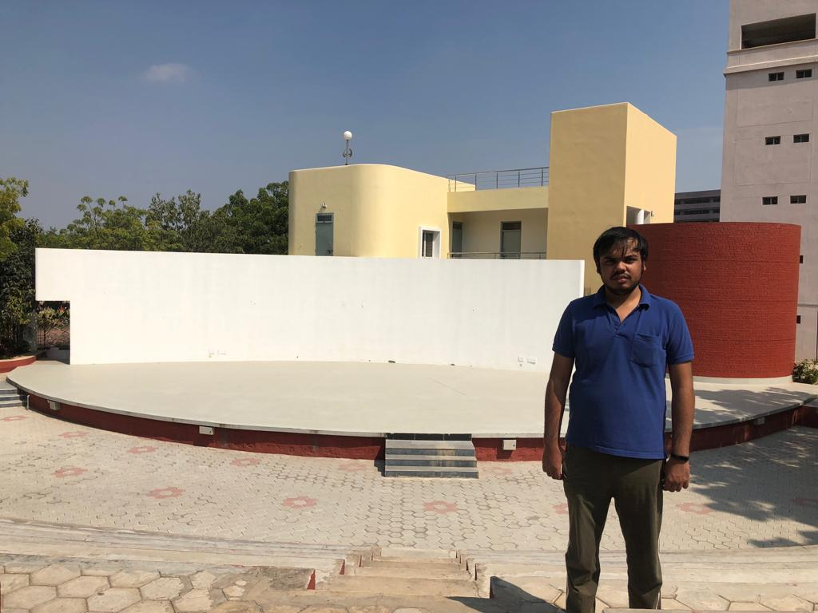
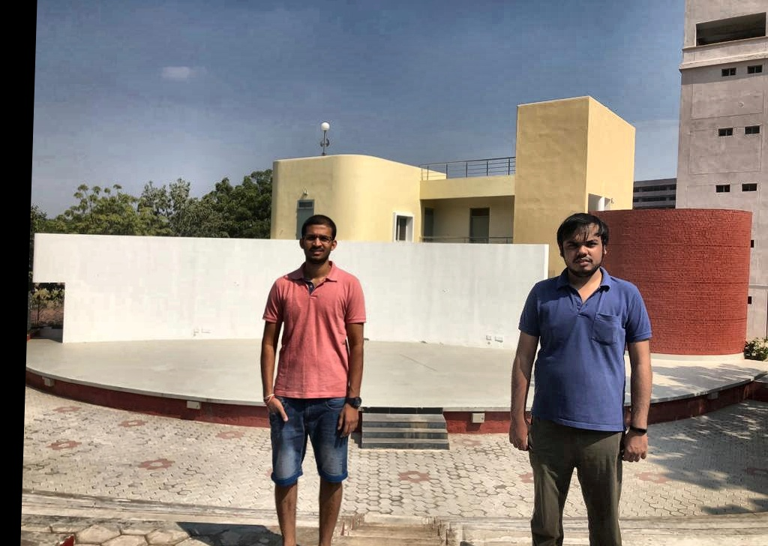
Problem Statement
Merge two portraits of individual people to create a of multi person photo.
+
=
Input 1
Input 2
Expected Output
Notes:
Our Problem statement is given two images of individual people, we would like to create a multi person single photo. Do we really need this in this selfie era? Yes we still consider to be clicked by another person when we have to capture a lot of background. And that motivates us in attempting this problem.

Slide 3
Pipeline of the project
Color Correction
Face and body detection
Keypoint Matching
Homography
Blending
Alpha Blending
Grabcut
Survey
Limitations & Analysis
Notes:
The pipeline of the project is as follows

Slide 4
Color Correction
Convert images to LAB color space
This would allow us to modify the lightness channel of the image without interfering with the color.
Perform Contrast Limited Histogram Adaptive Equalization on both the images.
This makes sure both the images have similar background lighting conditions to avoid artefacts while blending.
Notes:
Color correction is a the first step that we do to make sure both the images are having the same lightness level. Why is it important? Though most of the times it happens that we take images immediately but still there could be many factors affecting the lightness level of the image, even the amount of light falling on the sensor of the camera and angle has various effects on the lightness of the image. This step would avoid all such artefacts and make both the images lightness level matched which would help us to blend both the images at a later stage.

Slide 5
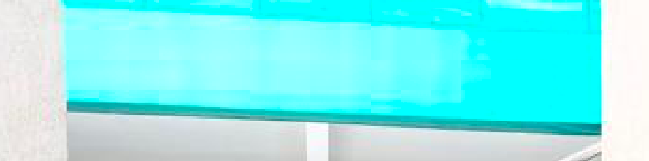
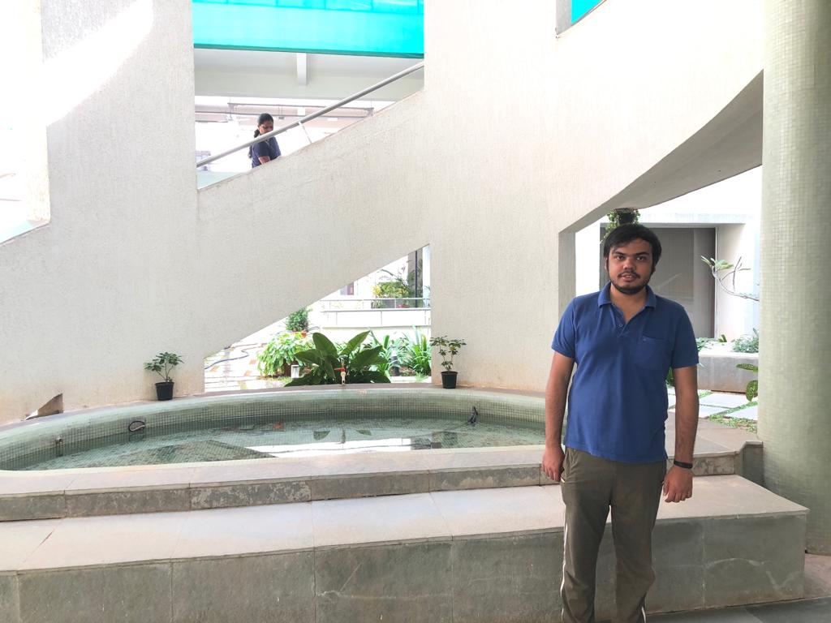
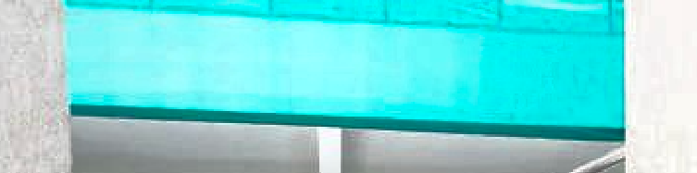
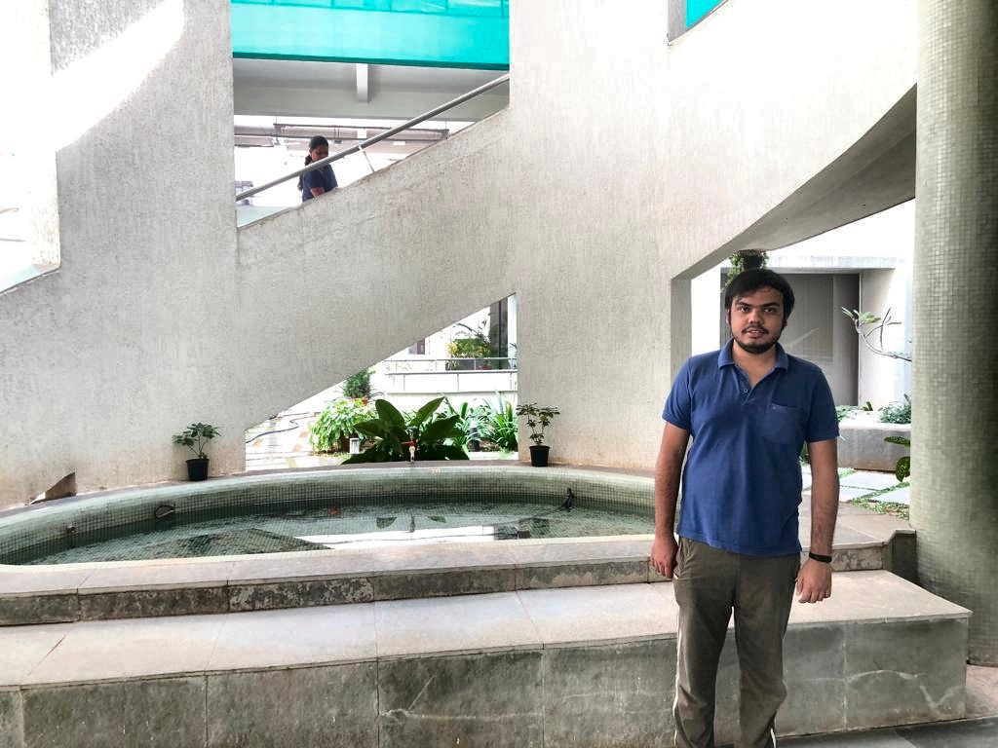
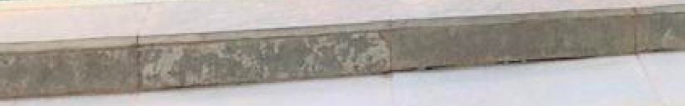
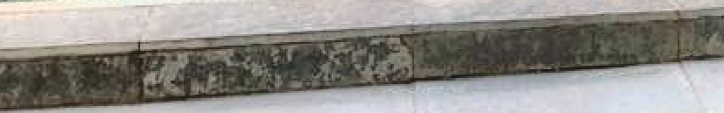
Original Image
Color Corrected Image
Notes:
Though the same could be achieved in various color spaces and various techniques like histogram matching, we resort to this technique as this not only matches the lightness level of the images but also enhances the minute artefacts of the image. This could potentially be a better keypoint, which will be explained in detail by my mate rudrabha. NEXT Rudrabha !

Slide 6
Face and body detection
Haar feature based cascade classifier is used for detecting face from the input image.
The original paper uses a static scale for detecting faces in the input image.
This scale does not work with many images in the dataset that we collected.
To generalize this, we iterate through different scales until a face is found, making it robust to many different scales.

Slide 7
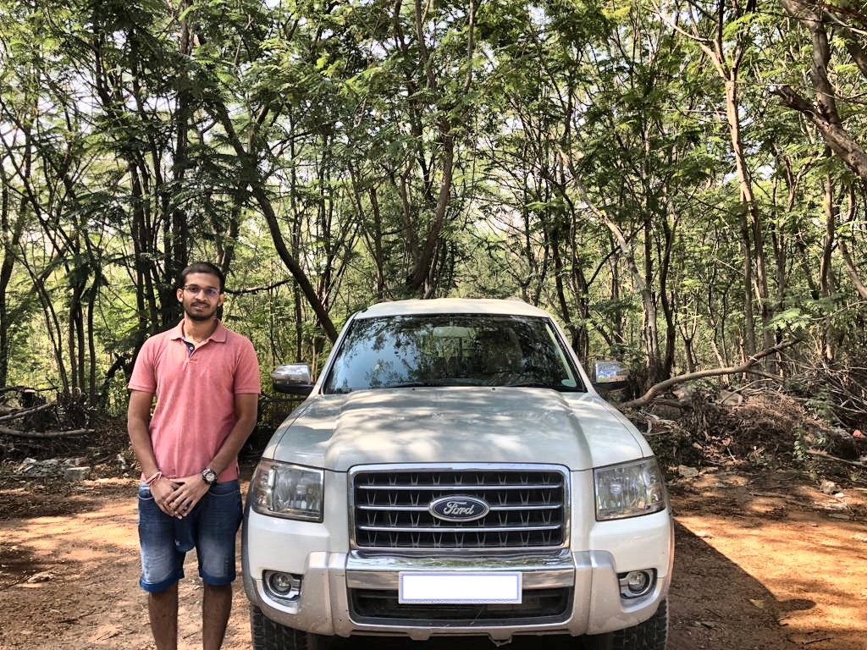
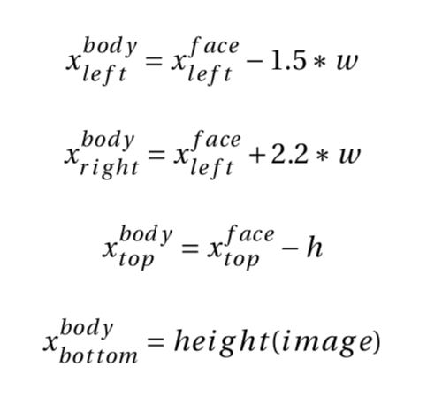
Sample input image
Notes:
We estimate the bounding box for the body from the bounding box of the face. We use these equations which we found empirically.

Slide 8
Keypoint detection & Matching
ORB keypoint detector is used to find key points in the image.
Total of 10000 key points are extracted from the image and only those key points outside the body locations of both persons in images are considered.
Notes:
We use ORB to detect keypoints. We find 10,000 keypoints for each image. We use ORB because it was used in the original paper. And it is faster in detecting 10,000 keypoints than SIFT.

Slide 9
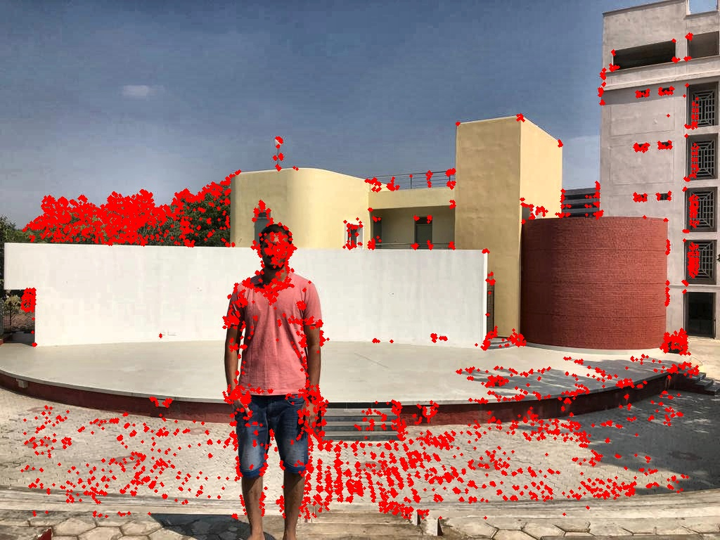
Keypoint Detection
All key points detected for the image
Sample input image with keypoints detected.
Notes:
These are the detected keypoints. As we can see there are many keypoints that are detected inside the body so we need to remove them as we donot want them to match with any other keypoint in the other image. We remove any keypoints lying inside the bounding box of both images.

Slide 10
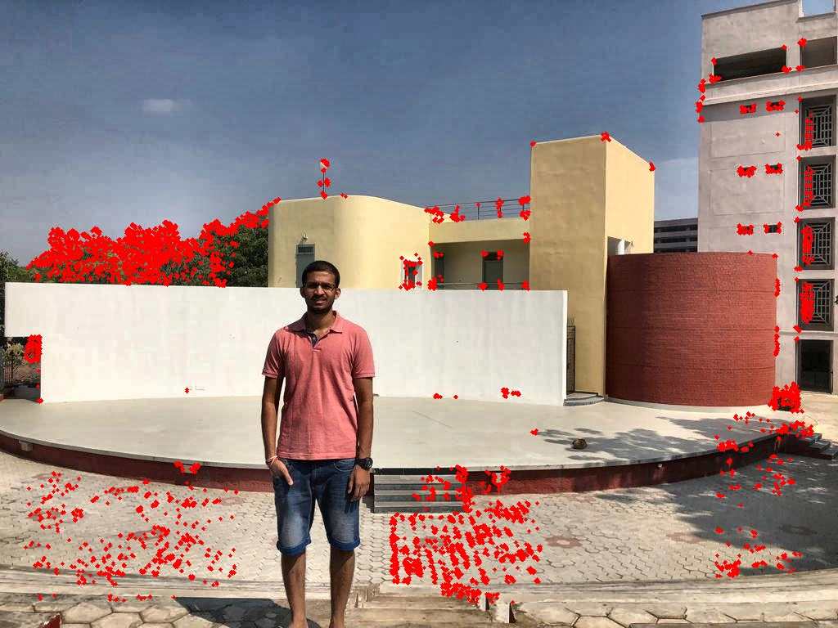
Keypoint Detection
All key points detected for the image
Considering only those key points outside the regions containing person
Sample input image with only valid keypoints.

Slide 11
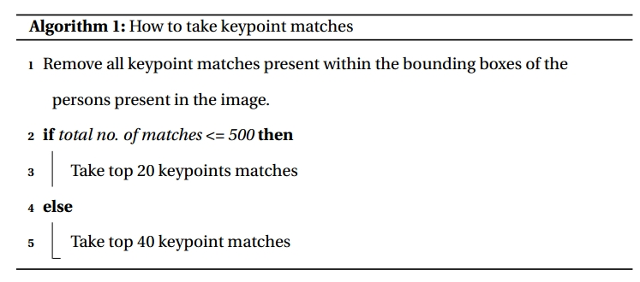
Keypoint Matching
Hamming distance is the metric considered for keypoint matching.
BFMatcher is used for keypoint matching based on the metric.
Algorithm:
Notes:
We then try to match the valid keypoints using brute force matcher based on hamming distance. So we follow the following algorithm. The original paper used a different algorithm. They found only 500 keypoints (instead of 10,000). Then they found the valid keypoints. They found the closest match and took threshold as 10 times that. That seems to work well only when we have a single large structure in the background

Slide 12
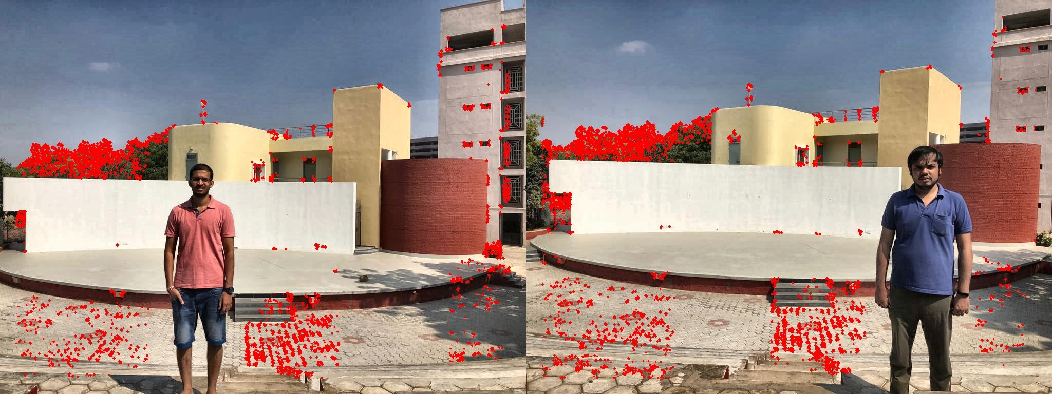
Keypoint Matching
All key points considered for both the images.

Slide 13
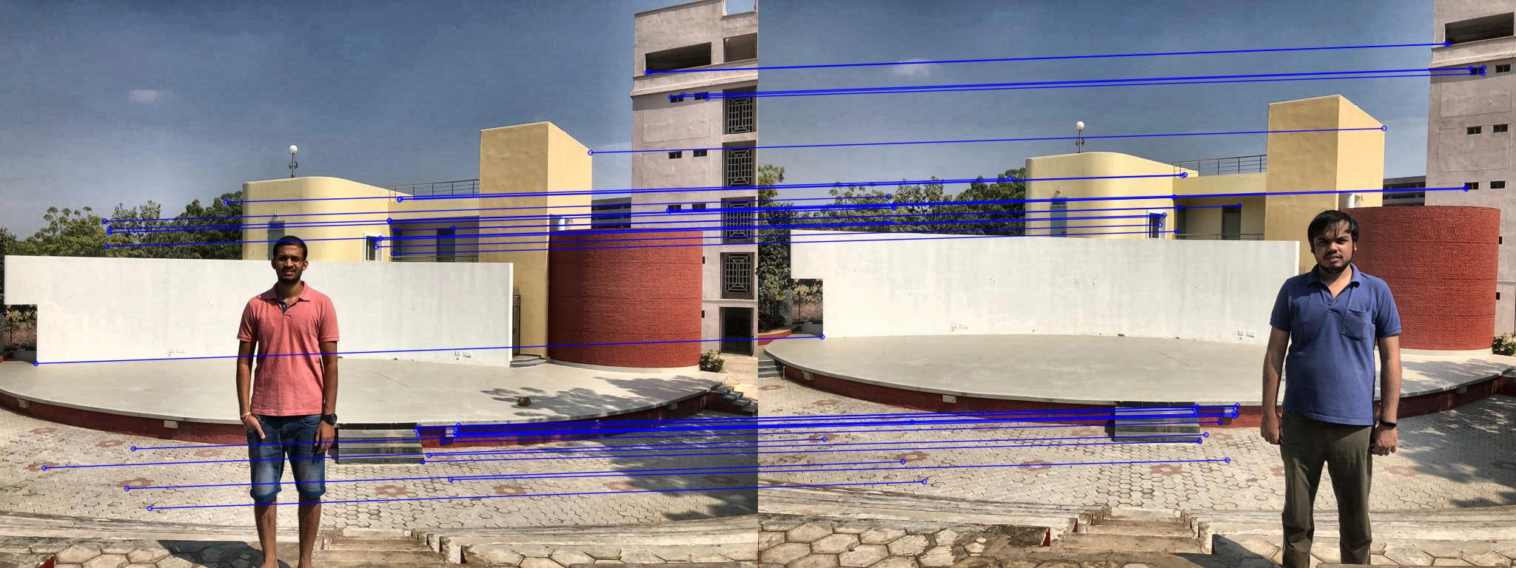
Keypoint Matching
Key points matched in both the images

Slide 14
Homography
Using the top k keypoint matches selected by the previous step, we create a homography matrix
Ransac algorithm is used to generate the homography matrix.
Once the homography matrix is created, we warp one image using the homography matrix to match with other.
This enables us to align two images without additional artefacts when merged together.
Notes:
We then use this keypoint matches to compute the homography matrix and warp the image.

Slide 15
Homography
Original Image

Slide 16
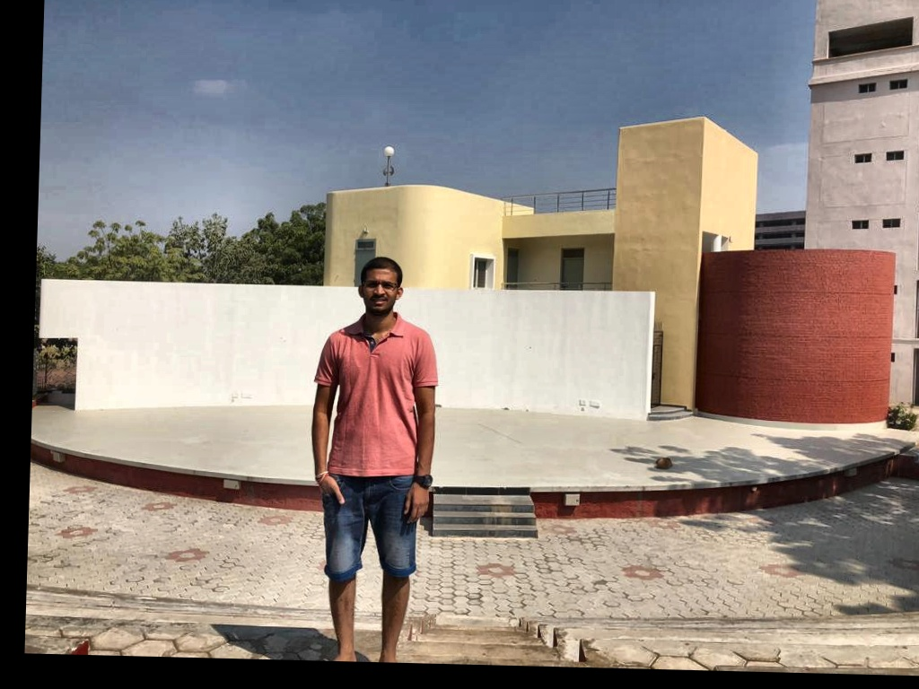
Homography
Warped Image
Notes:
Which results in something like this.

Slide 17
Blending
Blending is the final step to merge two images.
We follow two approaches for blending the images depending on the relative locations of the persons in images.
If both the locations are at least 100 pixels apart from each other then we do alpha blending else grabcut is done.
distance
Distance between body bounding box <=100
Yes
No
Grabcut
Alpha Blending
Notes:
Now that we have keypoints matched, and homography done, i.e one image aligned to another image. Our final step is to merge both images into single image. There are two cases that we encounter, one is where both the persons locations are relatively far or relatively close.

Slide 18
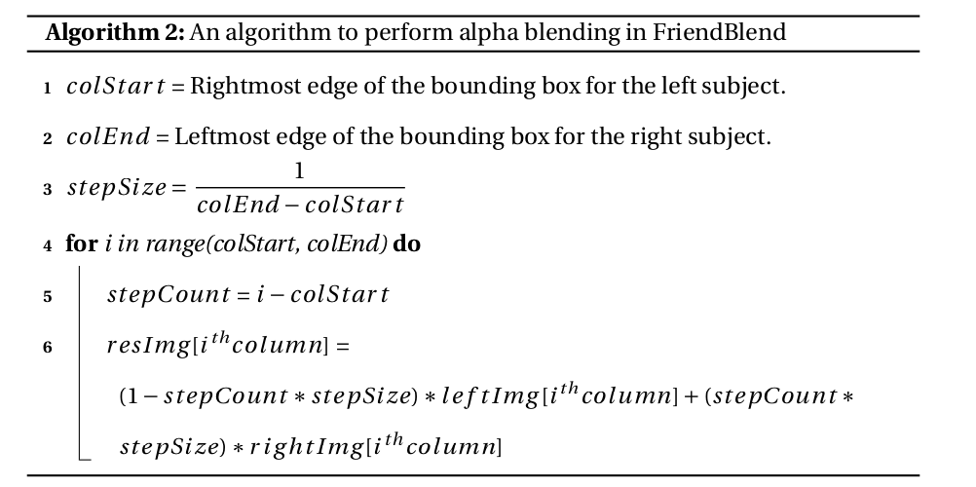
Alpha blending

Slide 19
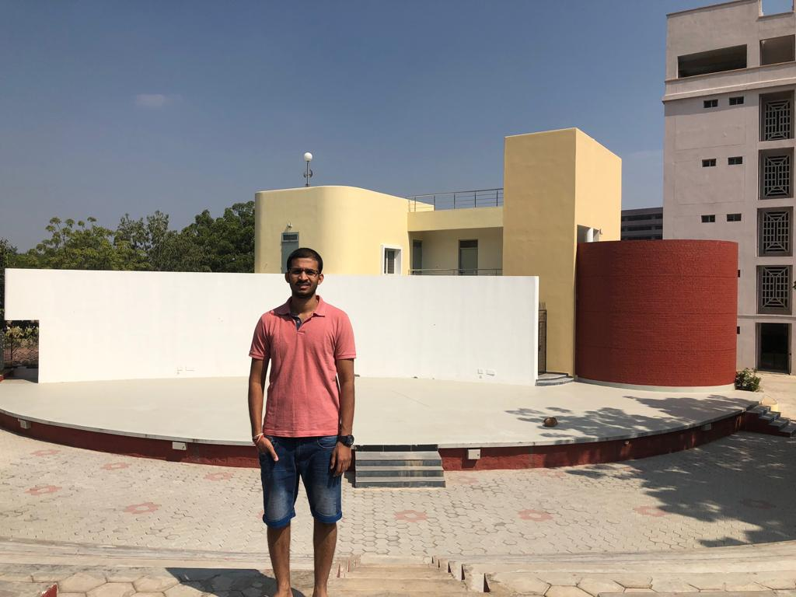
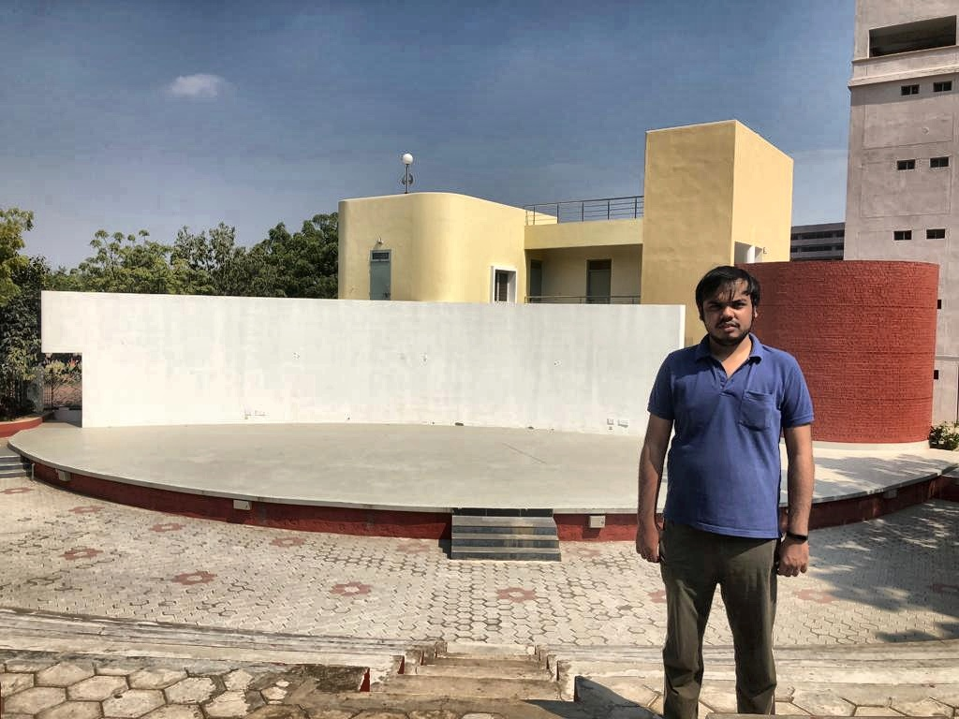
Alpha Blending result
Input 1
+
=
Input 2
Output from the algorithm after alpha blending

Slide 20
Grabcut
Grabcut is a technique used to segment out the foreground from background pixels.
This techniques requires labelling a few for sure foreground pixels and probable foreground pixels.
Internally it tries to model the pixels into two classes, foreground and background using Gaussian Mixture Models.
This outputs an image containing only the predicted foreground pixels, which acts like a mask.

Slide 21
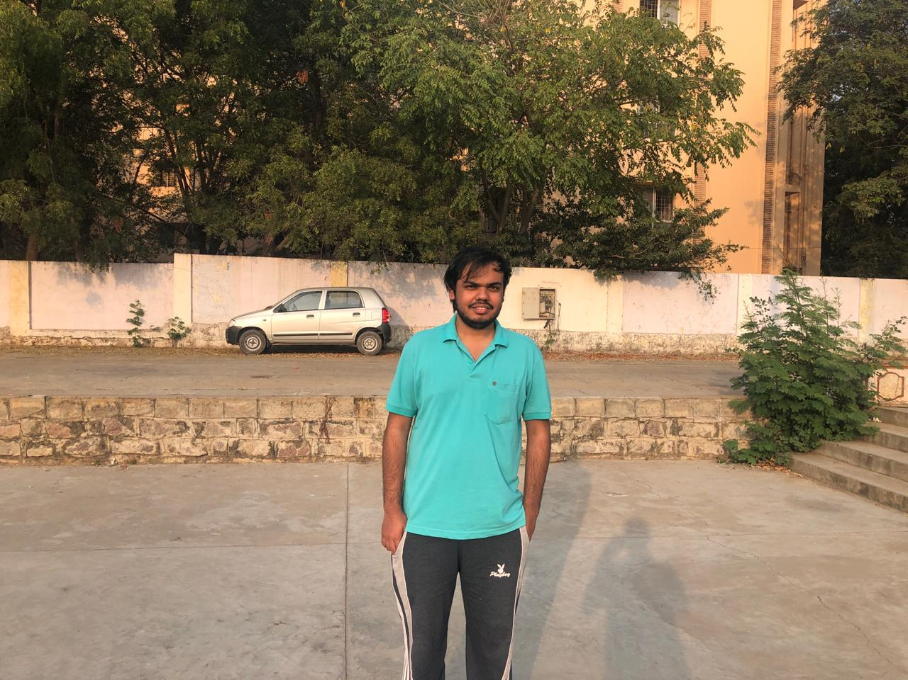
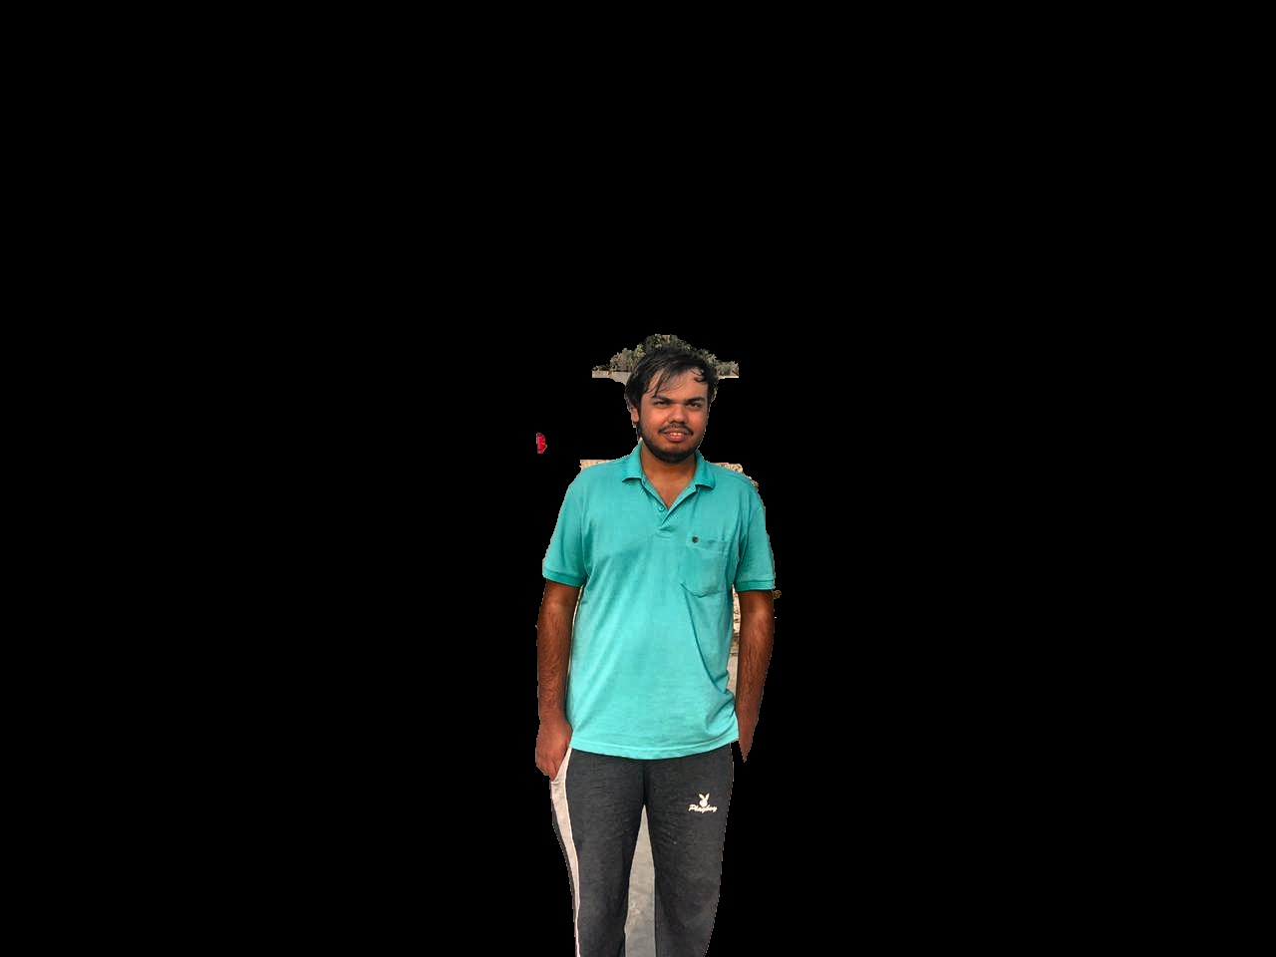
Grabcut - Binary Mask
Foreground
Probable Foreground
Input to grabcut with sure foreground and probable foreground
Binary mask output from grabcut

Slide 22
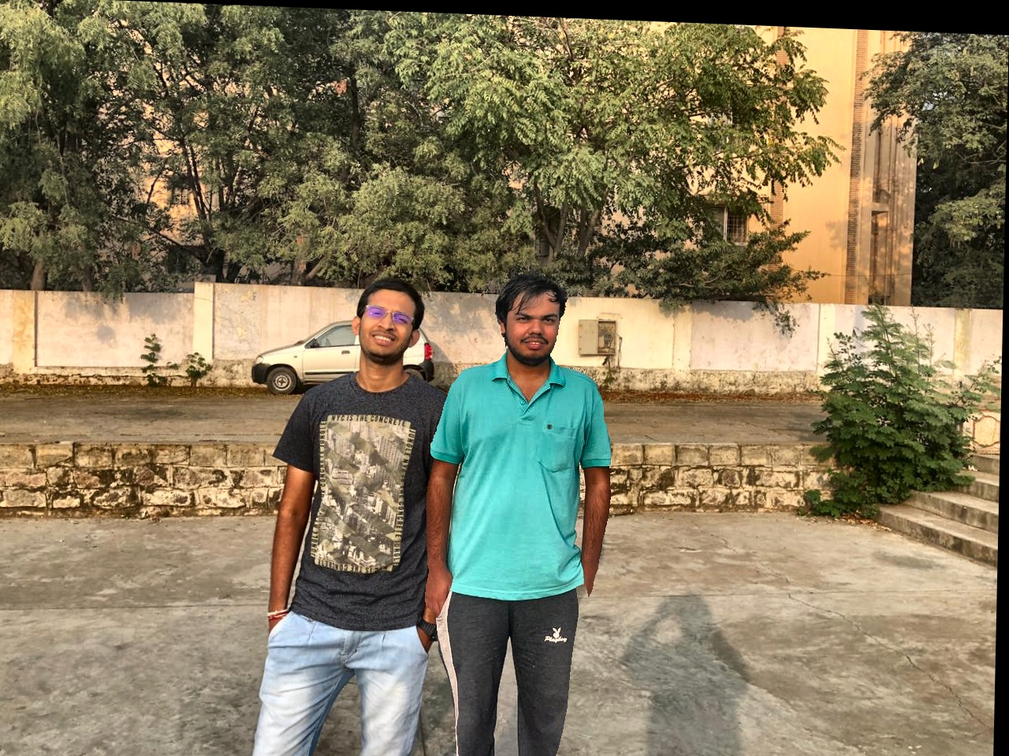
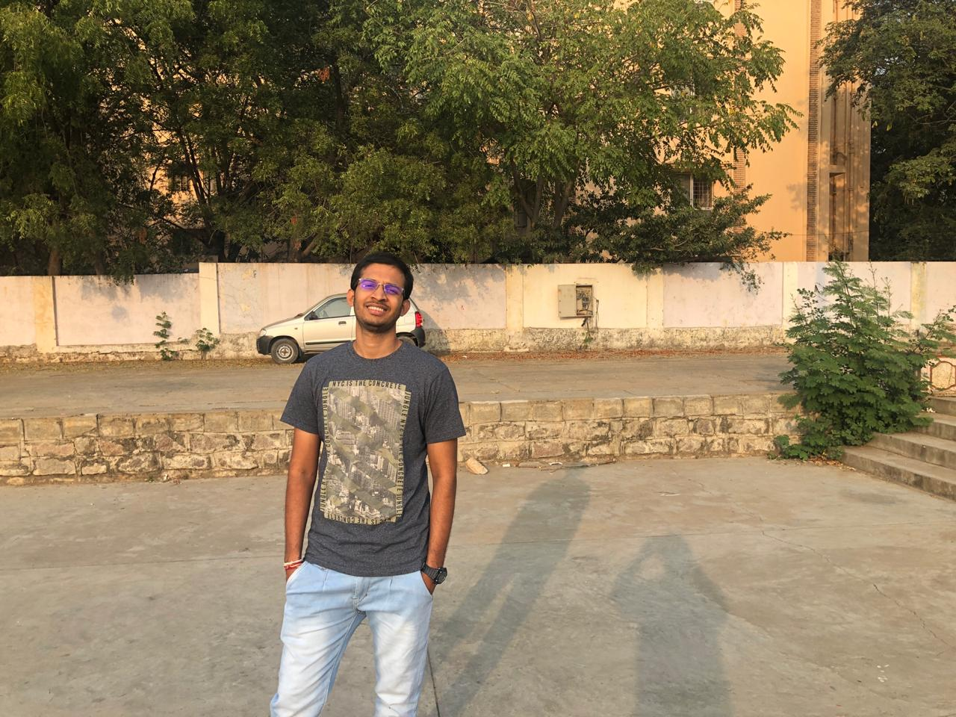
Grabcut Result
Input 1
+
=
Input 2
Output from the algorithm after grabcut

Slide 23
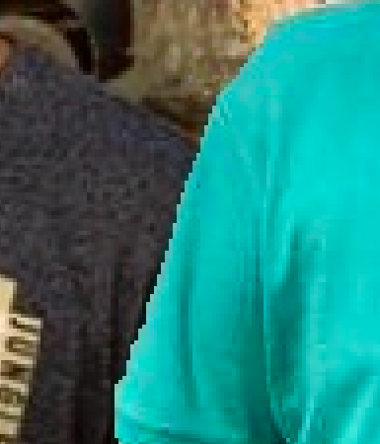
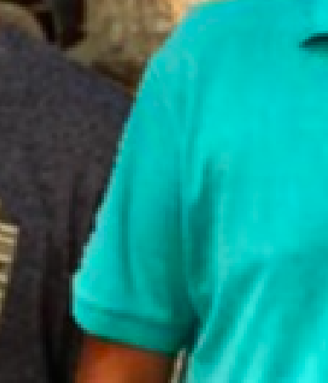
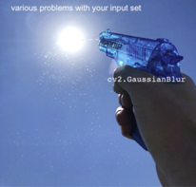
Edge artifacts
Edge effects before gaussian blur
Reduced edge effects after gaussian blur
Notes:
One common issue that we found with this technique is the sharp edges due to the mask, though we have used erosion using an elliptical structure as suggested in the paper, this still exists. So one profound technique sir was suggesting always throughout the course is :D

Slide 24
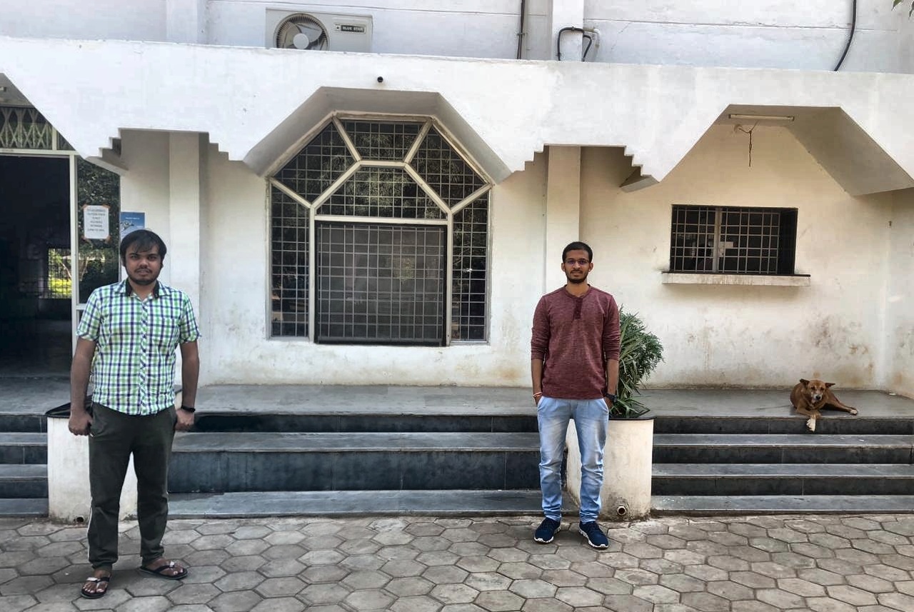
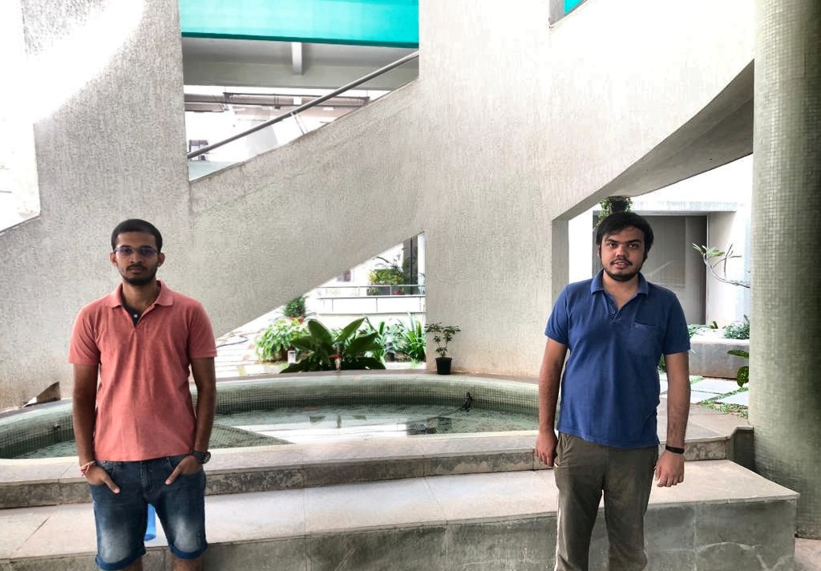
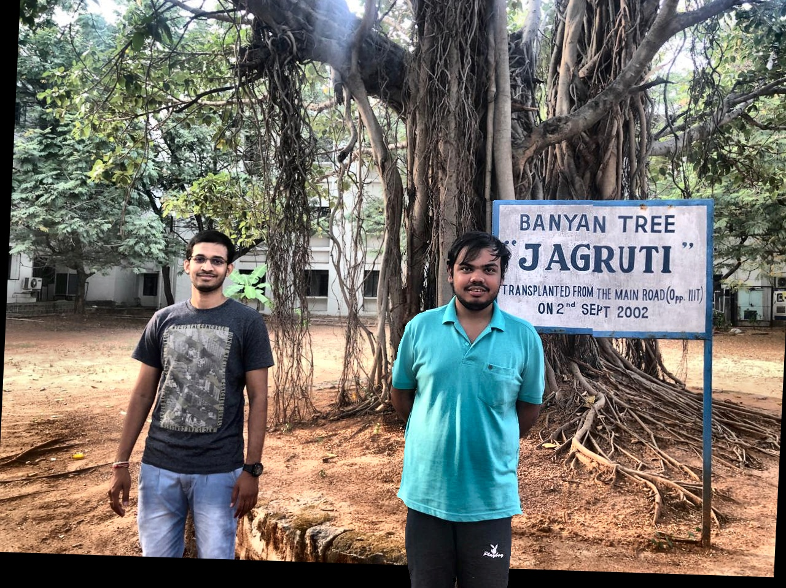
Qualitative Results

Slide 25
Quantitative Analysis
A survey has been conducted to rate the images produced by algorithm on show natural they look.
All the surveyors [30 in number] are of age group 23-26 working in same field with minimal/basic understanding of Digital Image Processing.
Average of the scores across all images stands at 3.73 on a scale of 1-5 1 being least and 5 the best.
Notes:
Since we do not have a metric to find/measure how good our algorithm performs overall, we have considered mean opinion score as metric.

Slide 26
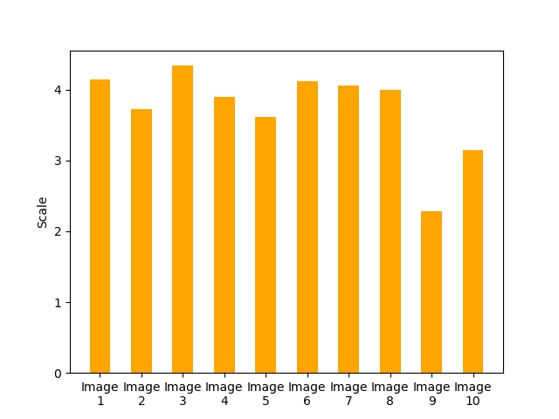
Survey Analysis
Mean = 3.73
Std Dev = 0.57
Notes:
NEXT Rudrabha !

Slide 27
Limitations
Homography being a very crucial step of the process, this algorithm inherently includes all the limitations of homography.
One of the major challenges was to make grabcut give better results. Still a challenge!
Different images though with same background but different in depths, have huge distortion when homography is applied and hence will result in poor results.

Slide 28
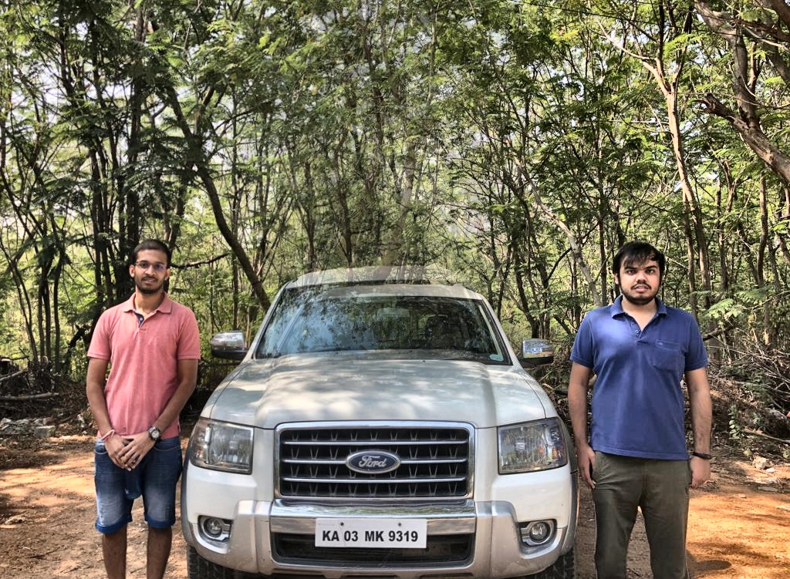
Homography
Improper alignment after alpha blending due to poor homography

Slide 29
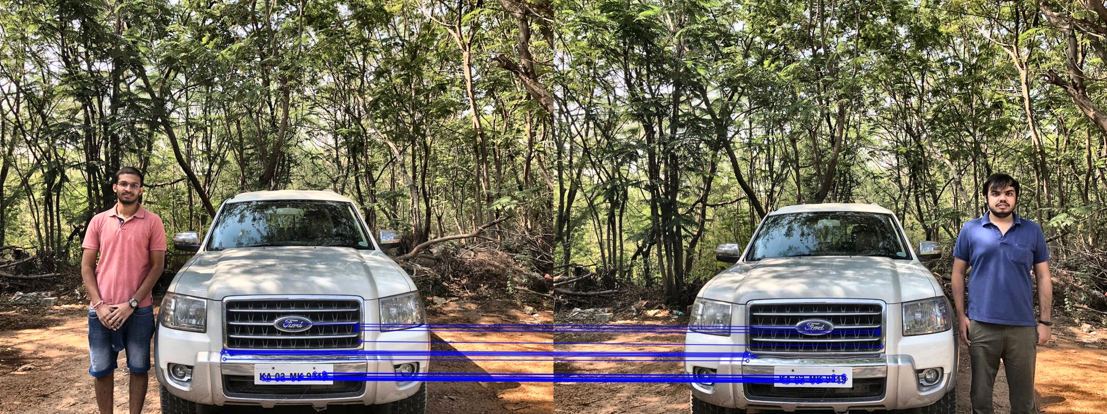
Analysis
N = 40
Image showing the key points used for matching when n = 40

Slide 30

Analysis
N = 100
Image showing the key points used for matching when n = 100

Slide 31
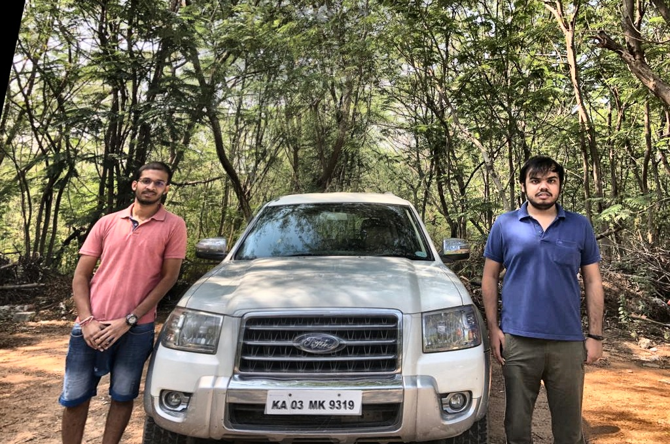
N = 40
N = 100
Output of algorithm using 40 keypoints
Output of algorithm using 100 keypoints

Slide 32
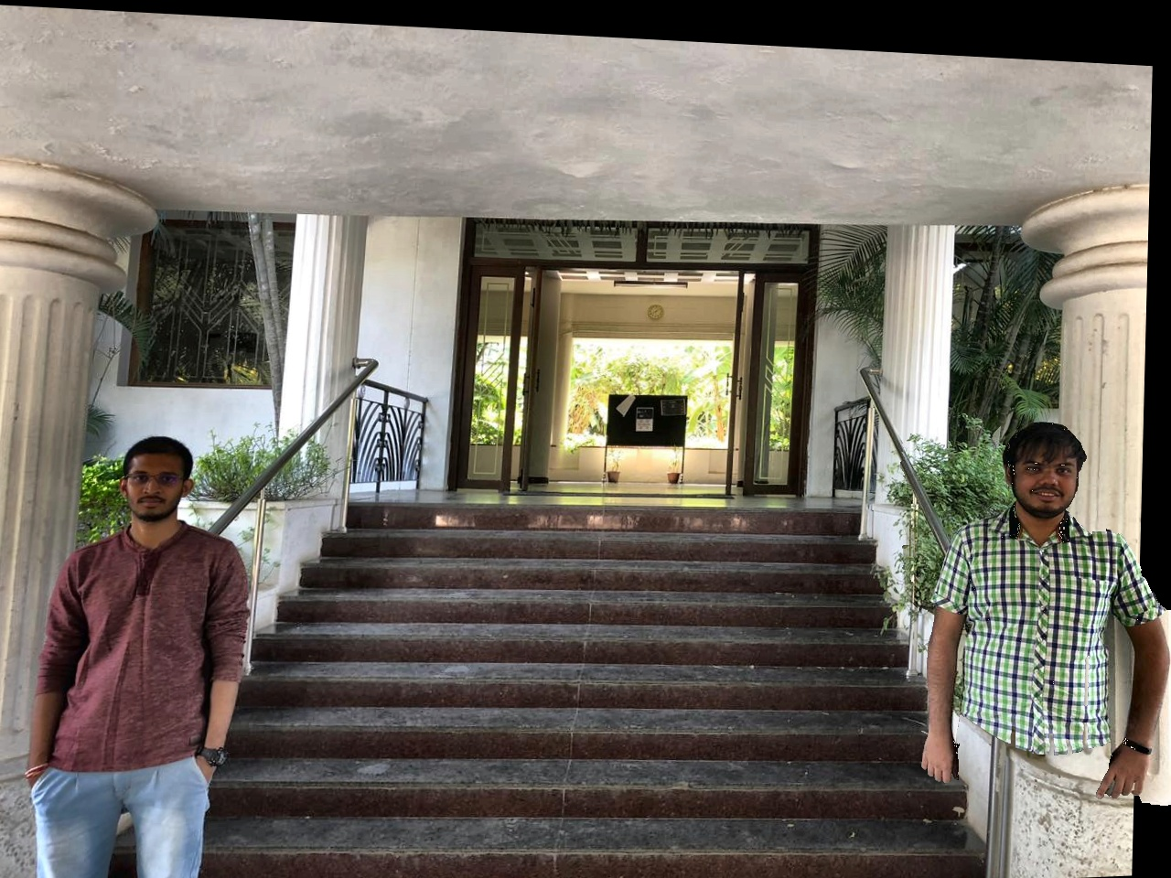
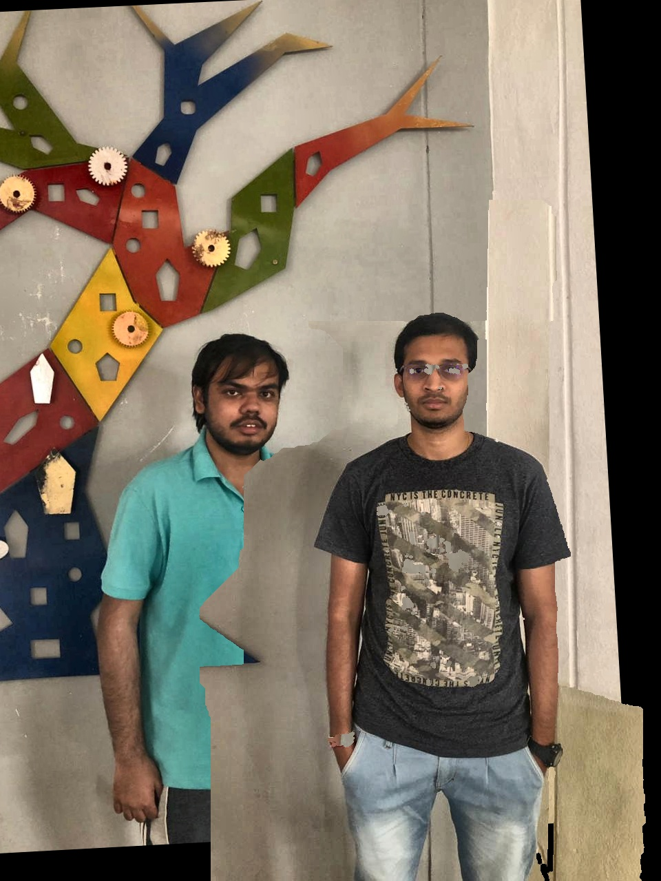
Grabcut
Images showing poor result due to improper grabcut result

Slide 33
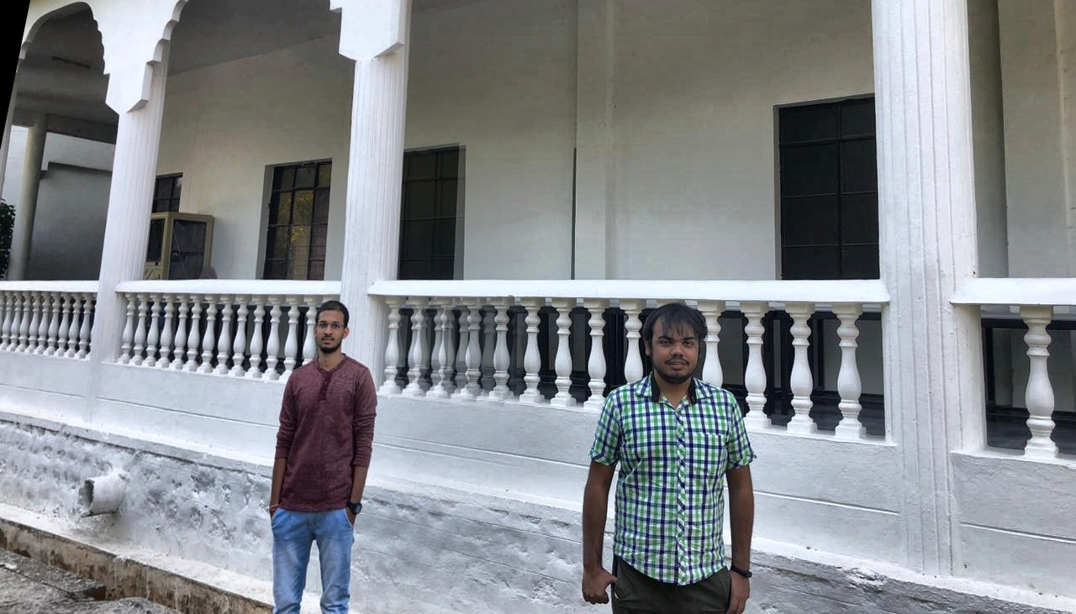
Depth variation
Poor result for improper

Slide 34
Contributions
Color Correction - Sangeeth
Face and body detection - Rudrabha
Keypoint Matching - Rudrabha
Homography - Rudrabha
Blending - Sangeeth
Alpha Blending
Grabcut
Public Survey - Sangeeth
Limitations & Analysis - Rudrabha
Project Report - Rudrabha
Project Presentation - Sangeeth

Slide 35


